Slide 1

MEDISPHERE AI
Next-Generation Healthcare Intelligence Platform powered by Agentic AI and Retrieval-Augmented Generation (RAG).

Slide 2
THE VISION
Bridging the gap between raw medical data and actionable clinical intelligence using autonomous reasoning agents.

Slide 3
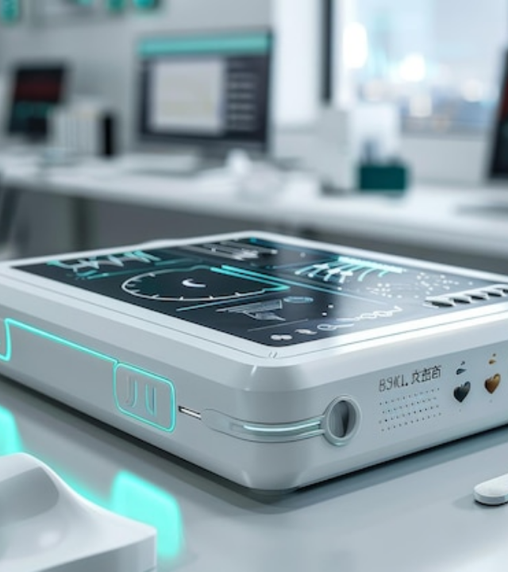
AGENTIC AI REASONING
More than just Chat
Our agents don't just find text; they reason across patient history, current symptoms, and clinical guidelines to suggest the next logical step in care.
Using autonomous task planning, MediSphere AI identifies critical risks before they escalate.

Slide 4

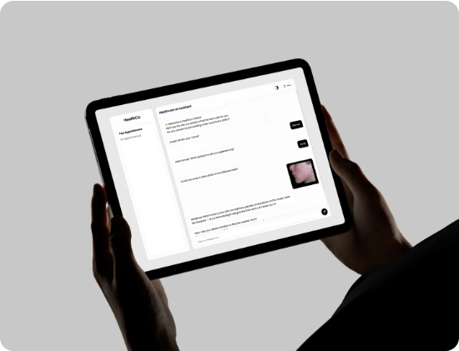
RAG-POWERED ASSISTANT
Contextual Intelligence
MediSphere uses Retrieval-Augmented Generation (RAG) to ground every answer in clinical reality.
•
Eliminates AI hallucinations with source grounding.
•
Scales with your custom medical documentation.
•
Provides actionable summaries for clinicians.

Slide 5
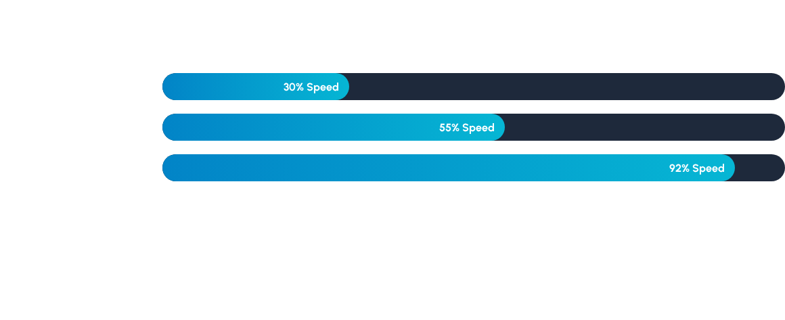
REDUCING READMISSION RISK
MediSphere AI achieves a 90% confidence score in identifying high-risk patients during the triage phase.

Slide 6






CORE CAPABILITIES
Patient Analysis
AI Assistant
Emergency
Detailed risk scoring based on longitudinal history and admissions.
24/7 symptom screening and preliminary diagnostic support.
Real-time detection of high-risk cardiac or respiratory symptoms.

Slide 7







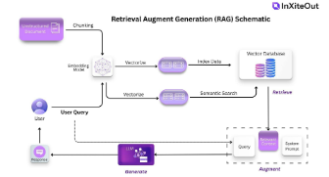
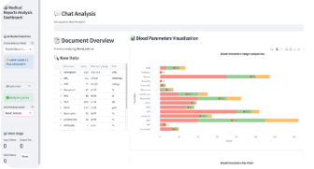
THE TECHNOLOGY STACK
Agentic AI
RAG Pipeline
Streamlit
Goal-oriented reasoning and autonomous execution.
Efficient retrieval from clinical knowledge bases.
Seamless, interactive healthcare data dashboards.

Slide 8

ACCURACY AND TRUST
87%
Global Accuracy Rate
Achieving state-of-the-art precision in medical information retrieval.

Slide 9

WHY AGENTIC AI?
Autonomous Planning: Agents break down complex symptoms into logical investigation steps.
Impact Summary
Source Grounding: Every diagnostic hint is mapped back to clinical literature.
By moving beyond simple keyword search to true reasoning, MediSphere AI acts as a digital co-pilot for healthcare providers, reducing administrative load by up to 40%.
Real-time Iteration: Self-correcting logic ensures the most relevant data is fetched first.

Slide 10

"AI will not replace physicians, but physicians who use AI will replace those who don't."
— The Future of Healthcare

Slide 11

TRY THE LIVE APP
medisphere-ai-kd.streamlit.app
Scan clinical symptoms, analyze patient risk, and explore agentic intelligence today.

Slide 12


THANK YOU
Let's transform healthcare together.

Slide 13





IMAGE SOURCES
https://img.freepik.com/premium-photo/futuristic-medical-device-with-blue-lights-modern-clinic-visualize-sleek-futuristic-medical-device-that-combines-traditional-health-monitoring-tools-with-cuttingedge-ai-technology_538213-87712.jpg
Source: www.freepik.com
https://kitrum.com/wp-content/uploads/2025/08/Medical-AI-Chatbot-2-n.webp
Source: kitrum.com
https://media.easy-peasy.ai/27feb2bb-aeb4-4a83-9fb6-8f3f2a15885e/4a6b20f1-93d6-46c9-8160-82a790687788_medium.webp
Source: easy-peasy.ai
https://images.prismic.io/inxiteout/aR2MHGGnmrmGqBAG_RAGSchematic-13-.jpg?auto=format,compress
Source: inxiteout.ai
https://d2908q01vomqb2.cloudfront.net/f1f836cb4ea6efb2a0b1b99f41ad8b103eff4b59/2025/09/25/ML-18400-image-2.png
Source: aws.amazon.com

